Slide 1

Materials and Energy System Modeling
Sebastian Zwickl-Bernhard, Marcus Otti, Helen Fischer, Sophie Hinterholzer, Hans Auer
www.tuwien.at | www.eeg.tuwien.ac.at

Slide 2
Motivation
May 2022 – present
Materials and Energy System Modeling

Slide 3
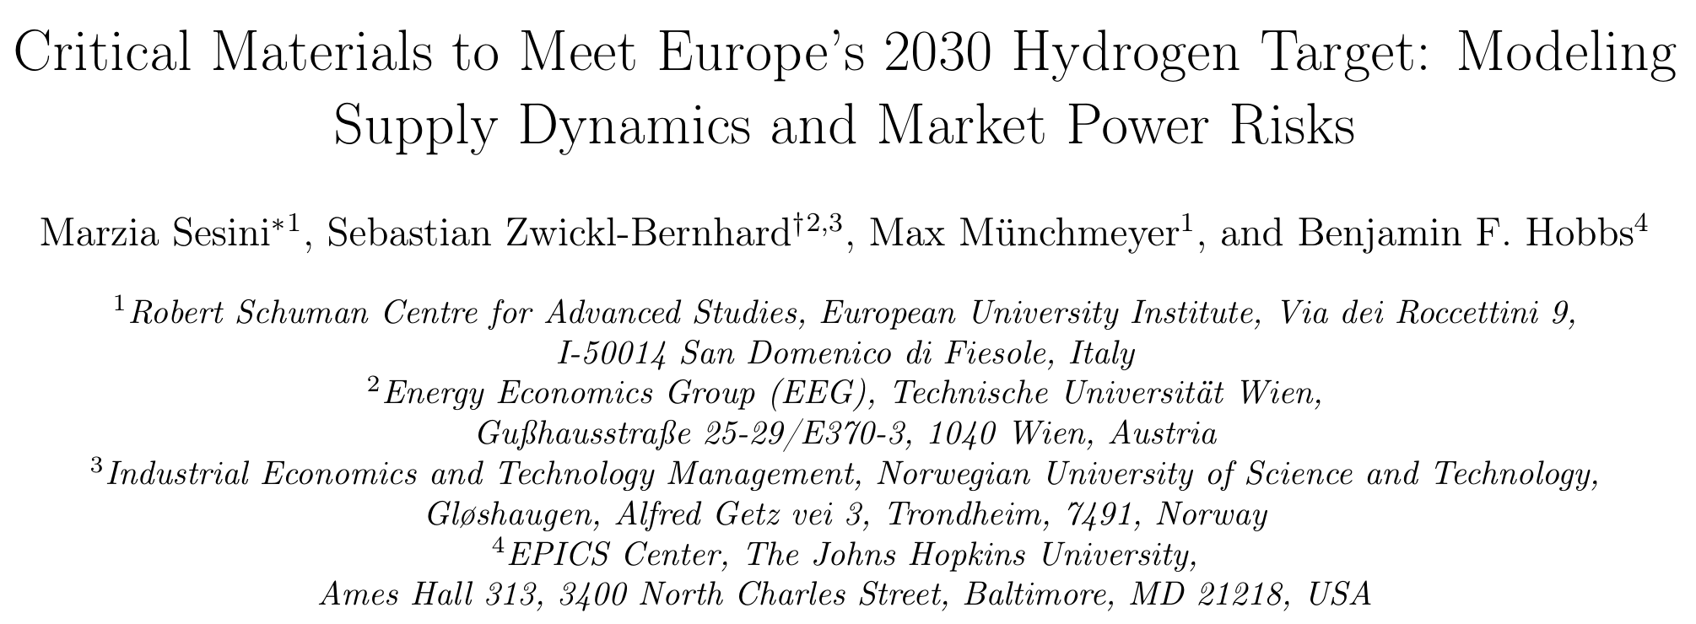
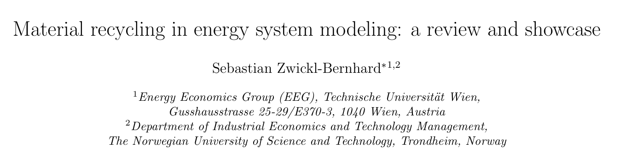
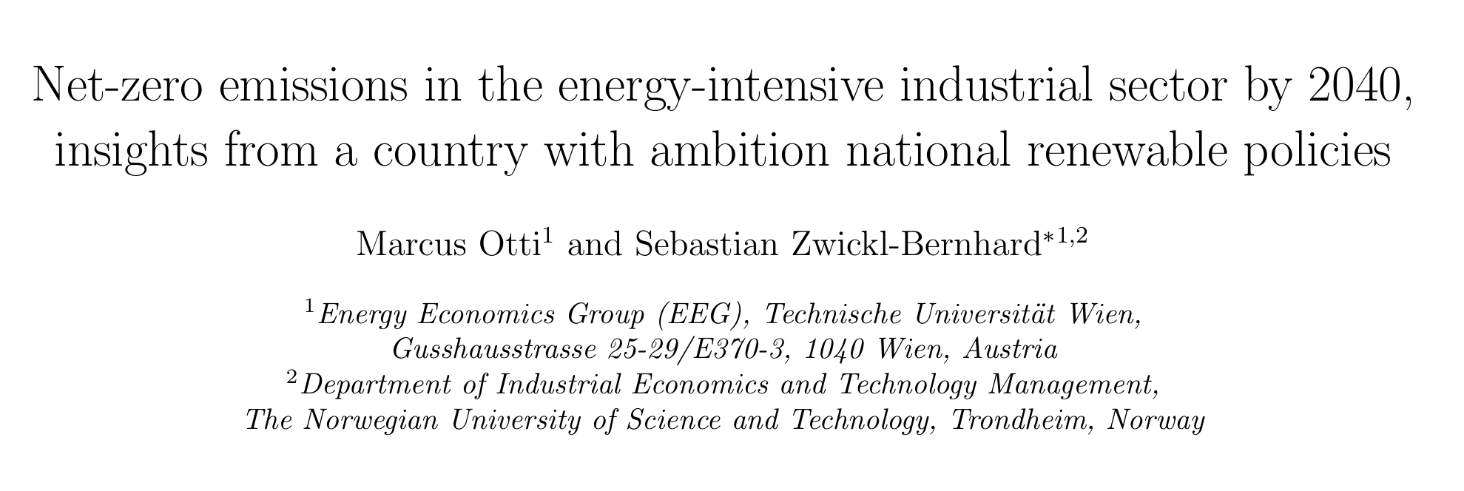
YEEES with Marzia Sesini (FSR) visiting us as senior reviewer
APEN-D-24-09197
ADAPEN-D-24-00247
August, 2024
May 2023
June, 2024
Late August, 2024
Techno-economic assessment of rare earth element recycling in the EU clean energy transition (Nikolaus)
Overcapacity in the global solar module market: Is short-term stockpiling closing the window for an EU solar module recycling industry? (Maximilian)
Shortly thereafter, we began working on a joint paper.
APEN-D-24-12813

Slide 4
Key findings regarding material recycling
“Within the European market context, results emphasize the critical role of diversified export sources and recycling in ensuring a stable supply.”
“… highlights the uncertainties surrounding recycling capacity, with market shares fluctuating due to industry immaturity…”
“… impact of material recycling on the profitability of industrial sectors would also be valuable.”
“Closely related to recycling is the future development of industrial production.”

Slide 5
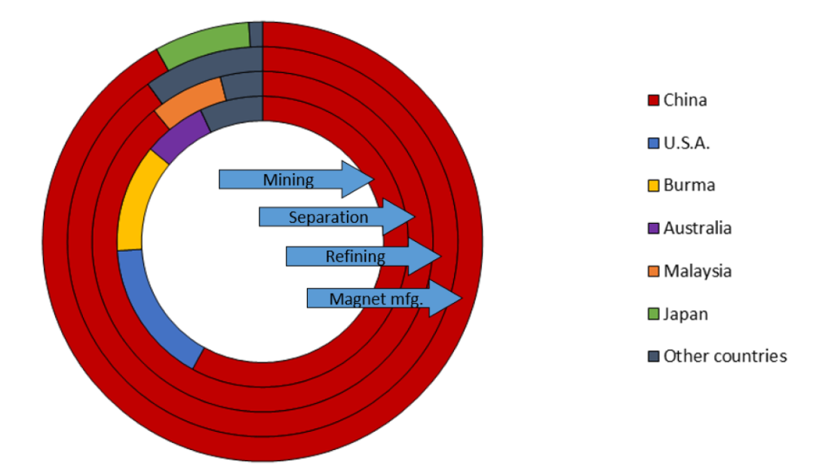
Origin of the REE for magnets
China, the US and Russia control 56% of global REE reserves
Only about 1% of REEs are currently recycled
Recycling neodymium from end-of-life magnets takes less than half (35%) of the energy needed to extract it from ores
US Department of Energy, “Rare earth permanent magnets: Supply chain deep dive assessment,” US Department of Energy, Tech. Rep., Feb. 24, 2022.

Slide 6
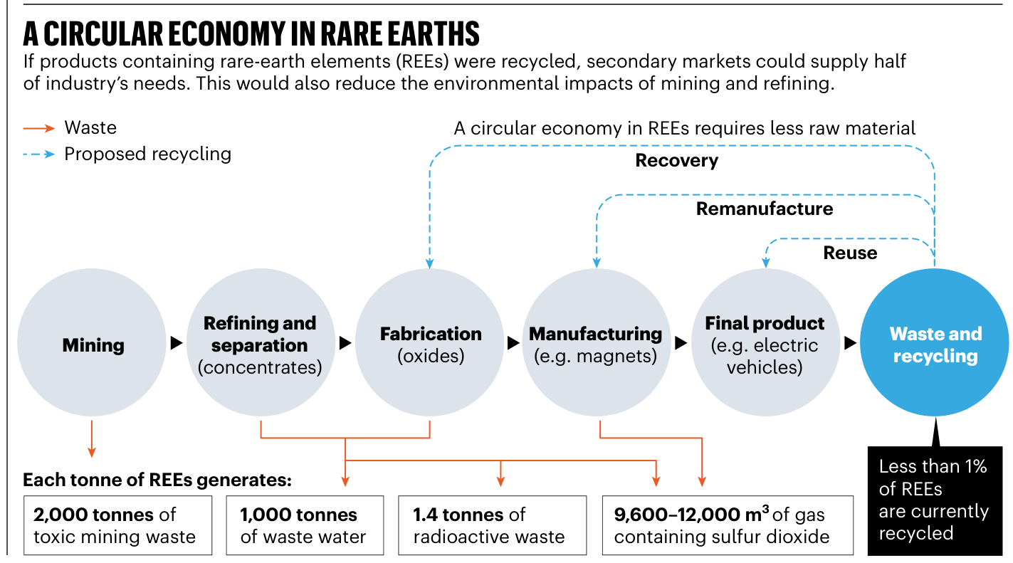

Slide 7
The research gap
Material demand & recycling in energy system modeling

Slide 8
„Material recycling in energy system modeling: a review and showcase“
Addresses the currently overlooked yet urgent topic of material recycling in energy system modeling, making three substantial contributions:
Presenting a comprehensive review of relevant studies on material demand, flows, and recycling from a techno-economic perspective.
Introducing a general mathematical framework for incorporating material recycling into typical energy system models.
Demonstrating the practical application of this approach by examining the material recycling potential within the solar module expansion plan of the European Union until

Slide 9
Key takeaways regarding the literature review
To our knowledge, Kullmann et al.'s study is the first and the only study that explicitly takes material recycling in an energy system model into account.
Even though several energy system models include all different sectors and green technologies, the issue of material demands is overlooked in almost all models, with only a few exceptions.
Schulze et al. present a comprehensive review of 72 publications, focusing on the integration of material demands into energy system models, revealing that currently, there is no available model that adequately addresses material demands in an endogenous manner.

Slide 10
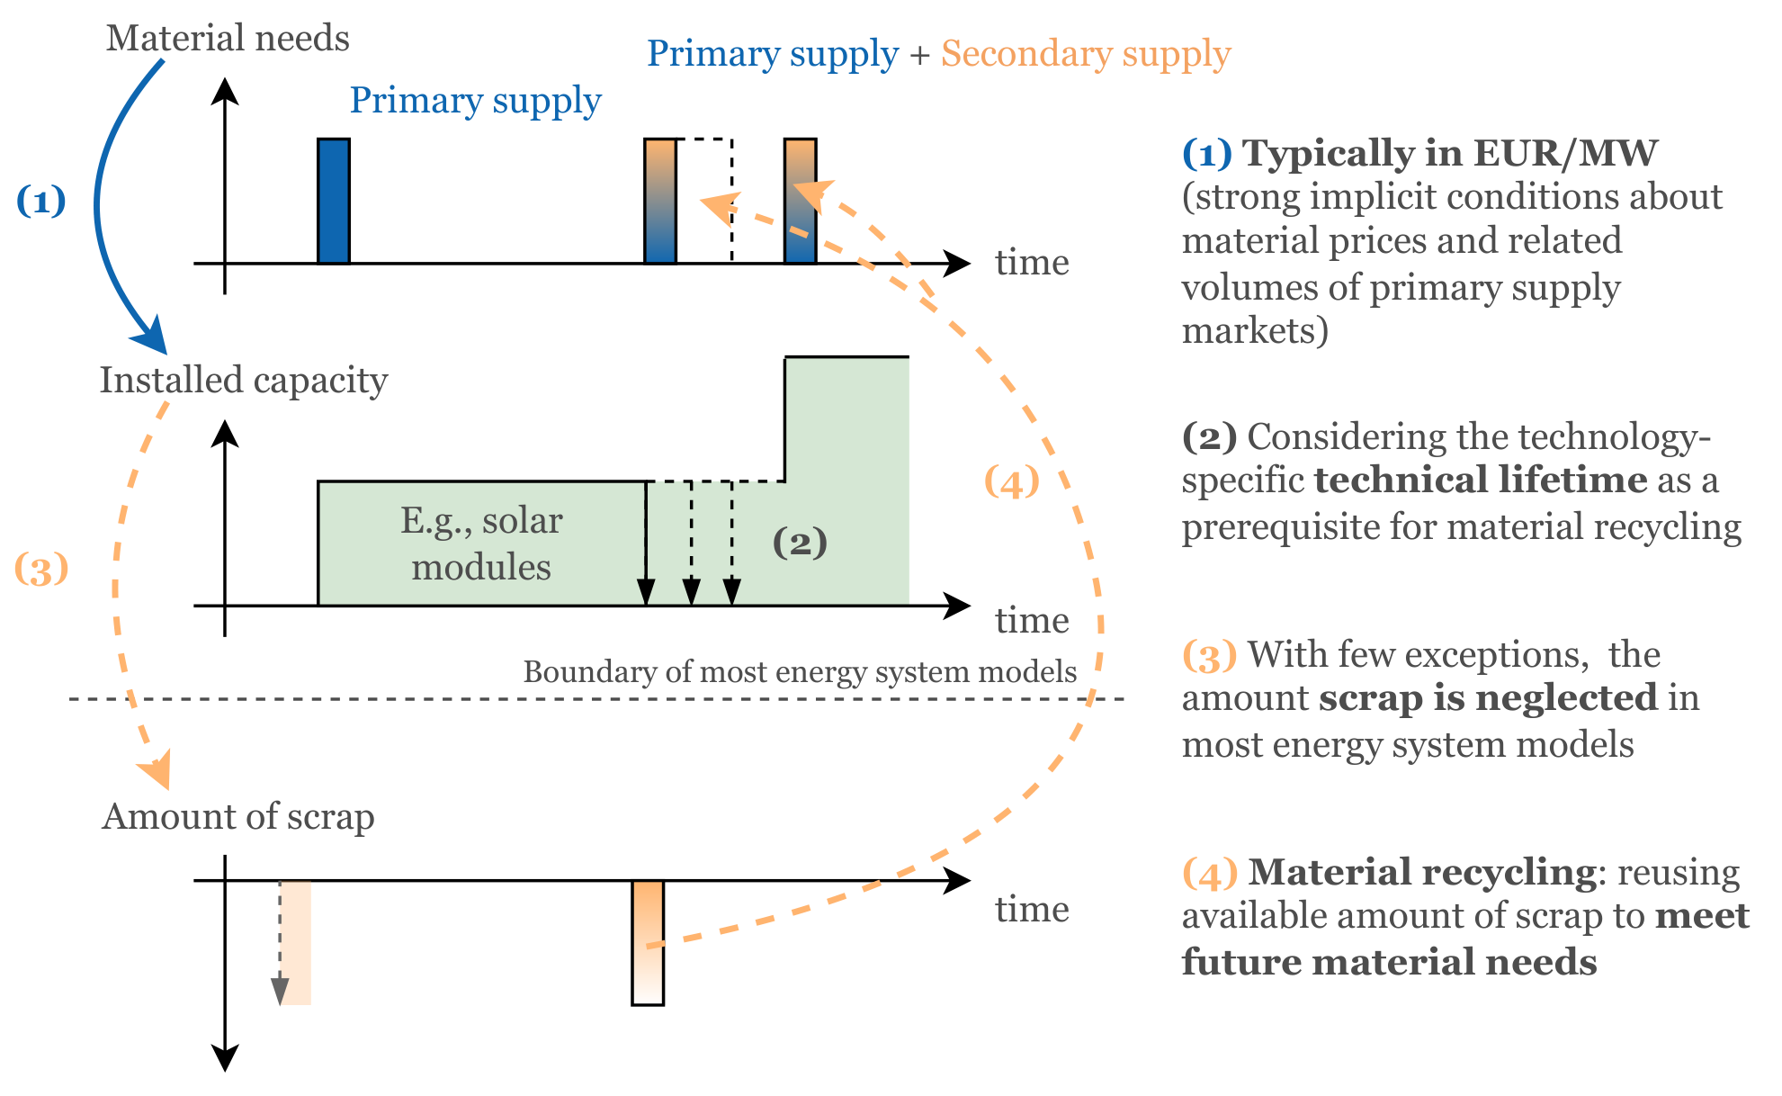

Slide 11
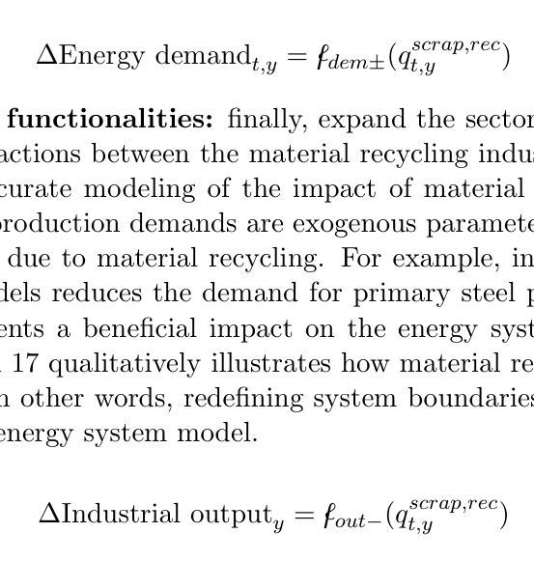
Step-by-step instructions for integrating material recycling into energy system models
a.) Consider the technology-specific technical lifetime
b.) Introduce variables for produced/available scrap
c.) Introduce variables for materials needs
d.) Adjust technology-specific investment costs
e.) Include energy demand for material recycling
f.) Extend sector-coupling functionalities
© Copyright- oder Quellenhinweis, ....
© Copyright- oder Quellenhinweis, ....

Slide 12
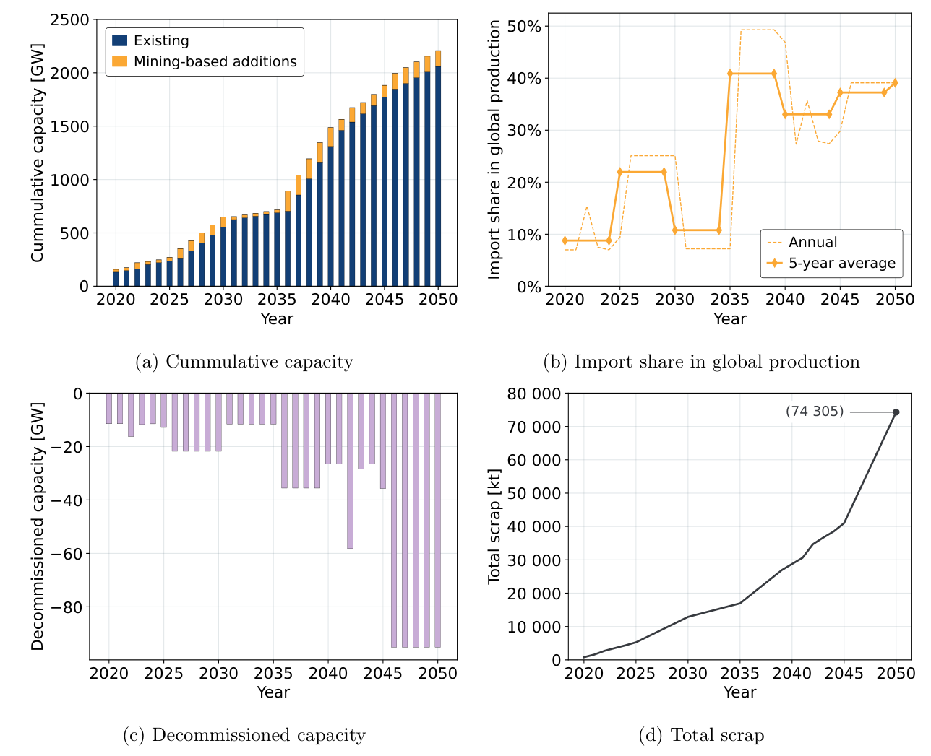
Development of solar modules in the EU-27 until 2050 in the scenario with optimistic market assumptions (as expected)
© Copyright- oder Quellenhinweis, ....

Slide 13
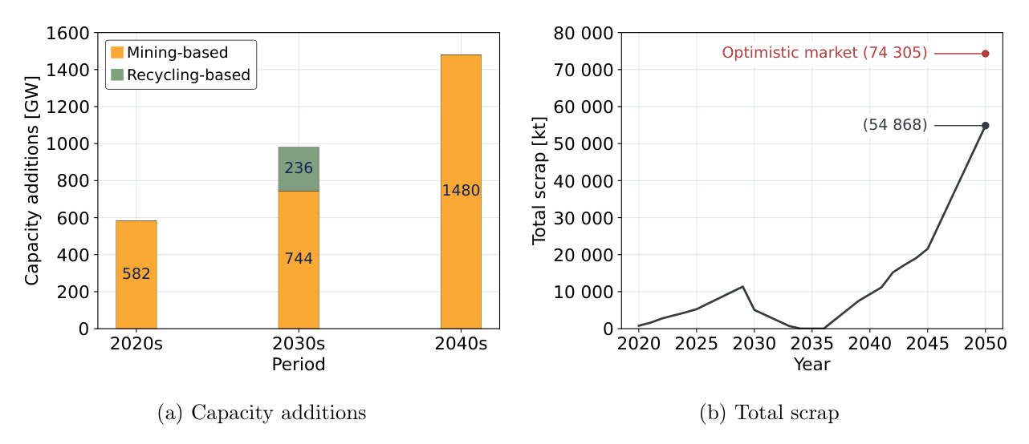
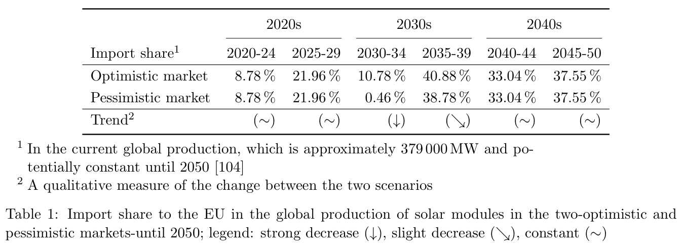
Development of solar modules in the EU-27 until 2050 in the scenario with pessimistic market
assumptions (surmised)
© Copyright- oder Quellenhinweis, ....

Slide 14
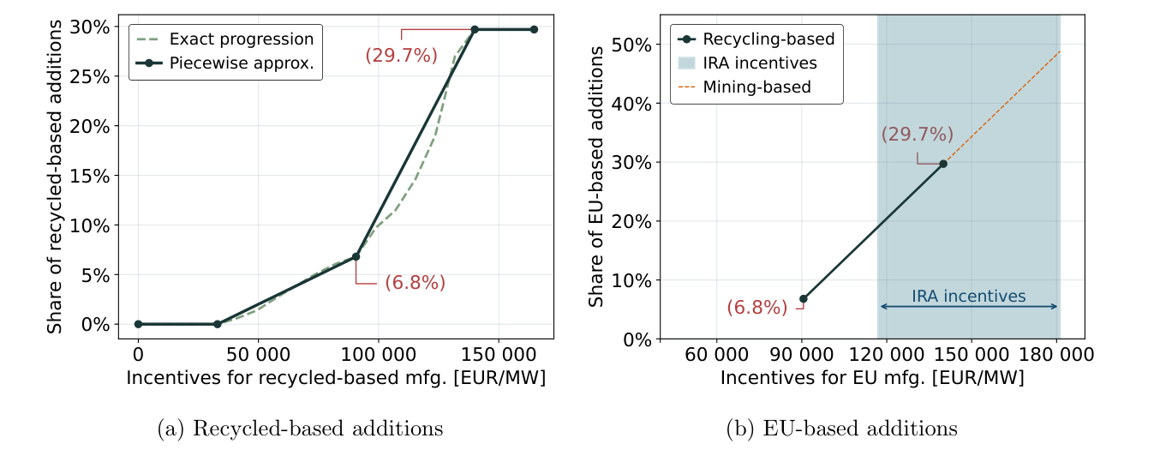

Slide 15
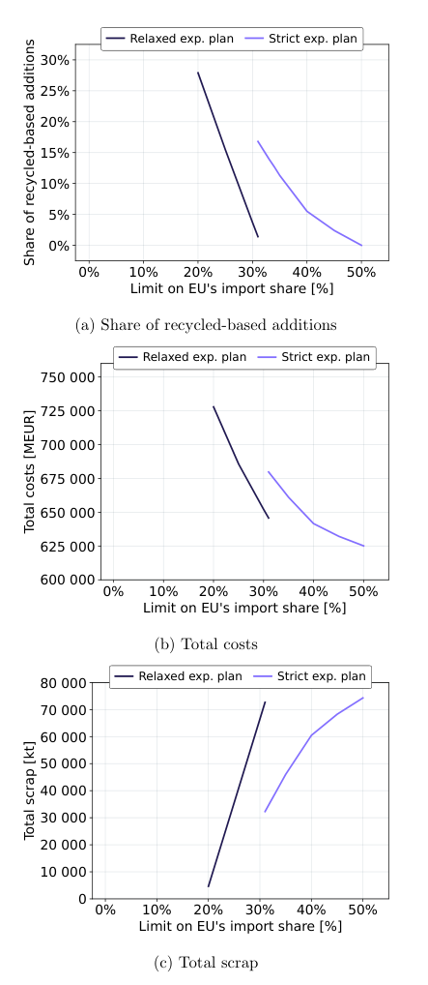

Slide 16
Conclusions
The results indicate that material-based additions could indeed play a considerable role, particularly in response to price signals triggered by a tight global market.
The dynamics of the recycling industry, or the global market as a whole, approximately 2040 or 2045, are possibly crucial in determining the extent to which the recycling industry can be firmly established.
Although manufacturers will need to compete globally with well-established players in a mature market, the recycle industry may have a future advantage due to the absence of an established market and entrenched competitors.

Slide 17
Future work
Enhancing the detail and accuracy of the techno-economic modeling of material recycling (open-looped and closed-loop recycling, etc.)
Furthermore, the dynamics of the whole recycling industry, including how it could be developed, established, and effectively supported, require further exploration (e.g., optimal localization of industrial sites)
Exploring the techno-economic implications of material recycling, particularly regarding stockpiling.

Slide 18
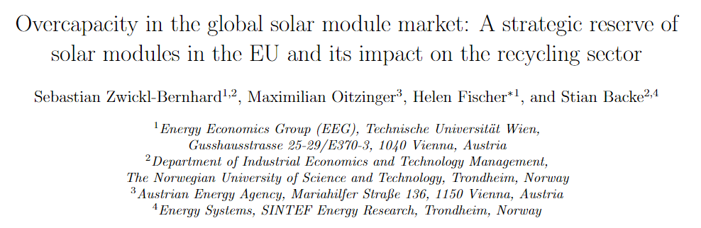
Ongoing work…☺

Slide 19
Contact
Sebastian Zwickl-Bernhard, Ph.D.
Technische Universität Wien
Energy Economics Group
Gußhausstraße 25 – 29 / E370-03
1040 Vienna, Austria
zwickl@eeg.tuwien.ac.at

